Slide 1
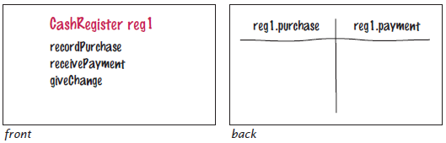

3.5 Problem Solving: Tracing Objects
Make a table for the values of the instance variables on the back
CashRegister class

Slide 2
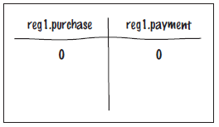
Problem Solving: Tracing Objects
When an object is constructed, fill in the initial values of the instance variables.
car1.make | car1.model | car1.year
lexus | gs350 | 2007

Slide 3
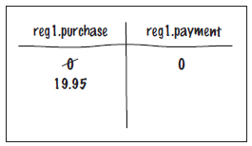
Problem Solving: Tracing Objects
Update the values of the instance variables when a mutator method is called.
After a call to cashRegister's recordPurchase method
CashRegister reg1 = new CashRegister();
reg1.recordPurchase(19.95);

Slide 4
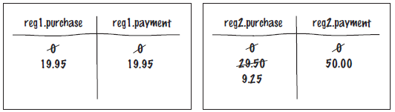
Problem Solving: Tracing Objects
More than one object: create multiple tables
car1.make | car1.model | car1.year
lexus | gs350 | 2007
car2.make | car2.model | car2.year
bmw | 350 | 2006

Slide 5
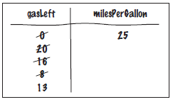
Self Check 3.18
Trace the following method calls – for a Car object with two instance variables: gasLeft and milesPerGallon
The constructor call initializes milesPerGallon with the number sent as an input parameter and the gasLeft is always set to 0.
Car myCar(25);
myCar.addGas(20);
myCar.drive(100);
myCar.drive(200);
myCar.addGas(5);
Answer:

Slide 6

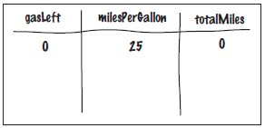
Self Check 3.19
Suppose you are asked to simulate the odometer of the car, by adding a method getMilesDriven. Add an instance variable to the object’s card that is suitable for computing this method’s result.
Answer:

Slide 7
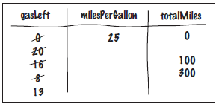
Self Check 3.20
Trace the methods of Self Check 18, updating the instance variable that you added in Self Check 19.
Answer:

